Slide 1







Mobile Phones
Jacky Tan - 2602162781
Rafael Adriel Wijaya - 2602102265
Reinhart - 2602162762

Slide 2


Introduction
Are you overwhelmed by the wide range of smartphone options available in the market today? Choosing the right smartphone that meets your customers tech needs can be a daunting task. With the rapid advancements in technology, staying up-to-date with smartphone specifications is essential. In this article, we will dwelve into the world of smartphone specifications to help you make an informed decision on behalf of your customer.
From processors and RAM to camera quality and battery life, every smartphone specification plays a significant role in how well it performs. Understanding these specifications and how they affect the overall user experience is key to finding the perfect smartphone for your customers.

Slide 3

An article titled “Usage of Principal Component Analysis (PCA)” by IBM. (n.d.)., highlights the importance of PCA in multivariate data analysis, emphasizing its ability to reduce dimensionality, extract important information, and visualize complex relationships between variables.
In the article of “The global k-means clustering algorithm” explains more about the global k-means algorithm which is an incremental approach to clustering that dynamically adds one cluster center at a time through a deterministic global search procedure
Literature Review
Another paper titled “Using K-Means Clustering to Cluster Provinces in Indonesia”, contains a research conducted using K-means clustering to cluster Indonesian provinces based on their geographical, economic, and demographic characteristics.

Slide 4
Source DataSet
Column Name | Data Type
# | Integer
Name | String
Brand | String
Model | String
Battery capacity (mAh) | Integer
Screen size (inches) | Float
Touchscreen | String (Yes/No
Resolution x | Integer
Column Name | Data Type
Resolution y | Integer
Processor | Integer
RAM (MB) | Integer
Internal storage (GB) | Float
Rear camera | Float
Front camera | Float
Operating system | String
Wi-Fi | String (Yes/No)
Column Name | Data Type
Bluetooth | String (Yes/No)
GPS | String (Yes/No)
Number of SIMs | Integer
3G | String (Yes/No)
4G/ LTE | String (Yes/No)
Price | Integer (in INR)

Slide 5
The DataSet
Column Name | Data Type
# | Integer
Battery capacity (mAh) | Integer
Screen size (inches) | Float
Resolution x | Integer
Resolution y | Integer
Processor | Integer
RAM (MB) | Integer
Internal storage (GB) | Float
Column Name | Data Type
Rear camera | Float
Front camera | Float
Number of SIMs | Integer
Price | Integer (in INR)

Slide 6
End2End Steps

Slide 7
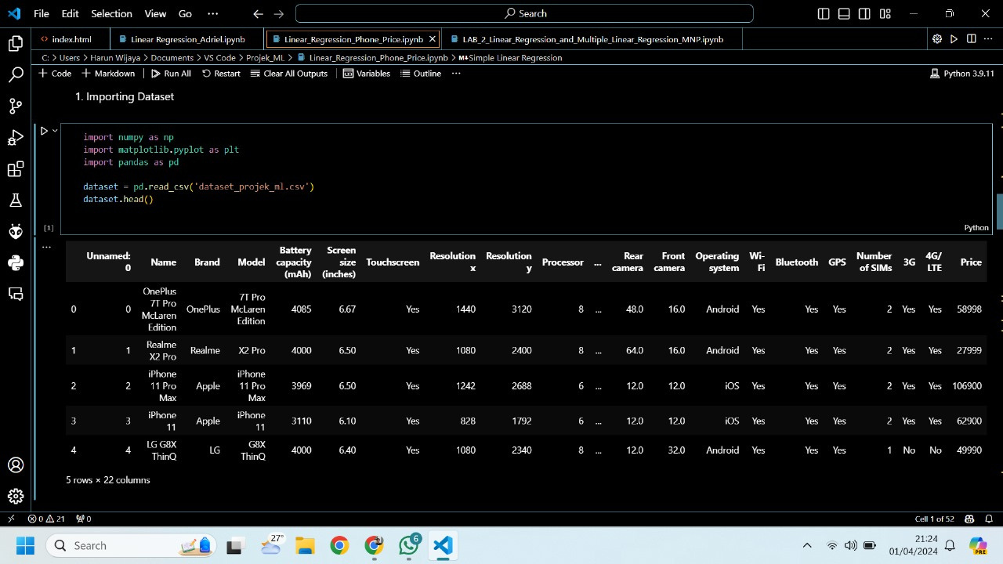
Data Visualization
First, the dataset was visualized in a table form to see all the features inside the dataset which can be seen on the number of variables present in the form of columns. In this dataset, there are 22 columns.

Slide 8
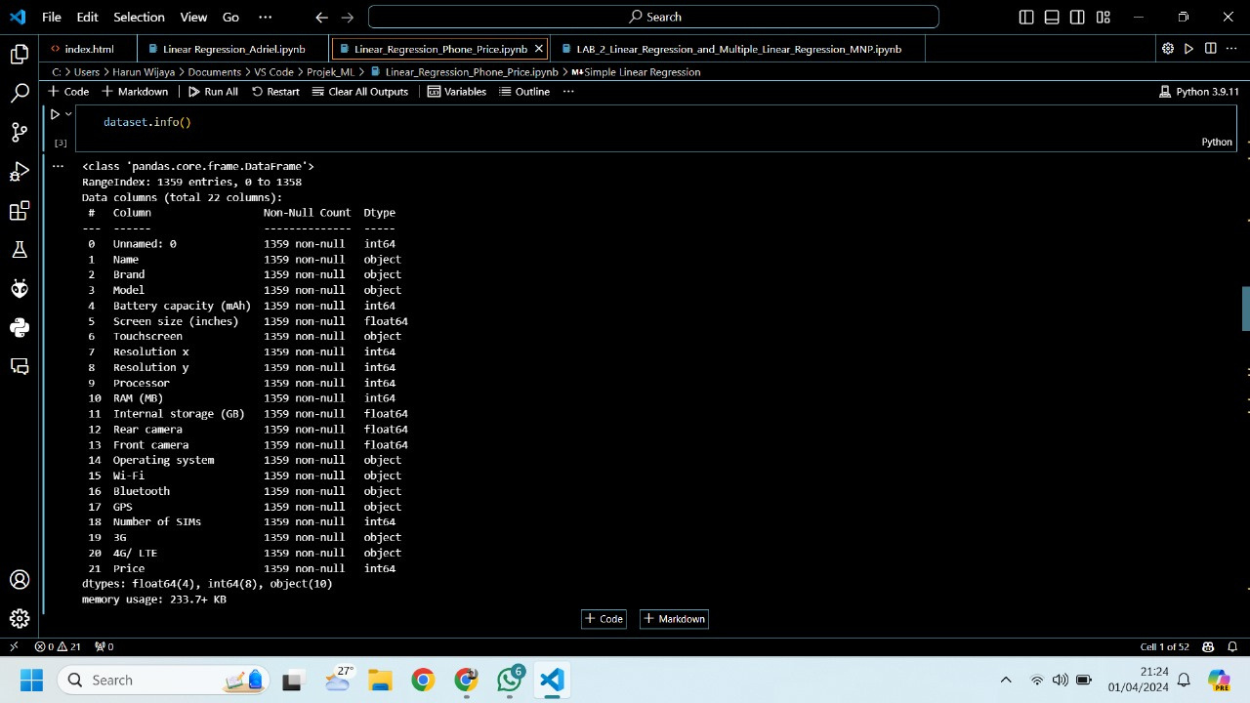
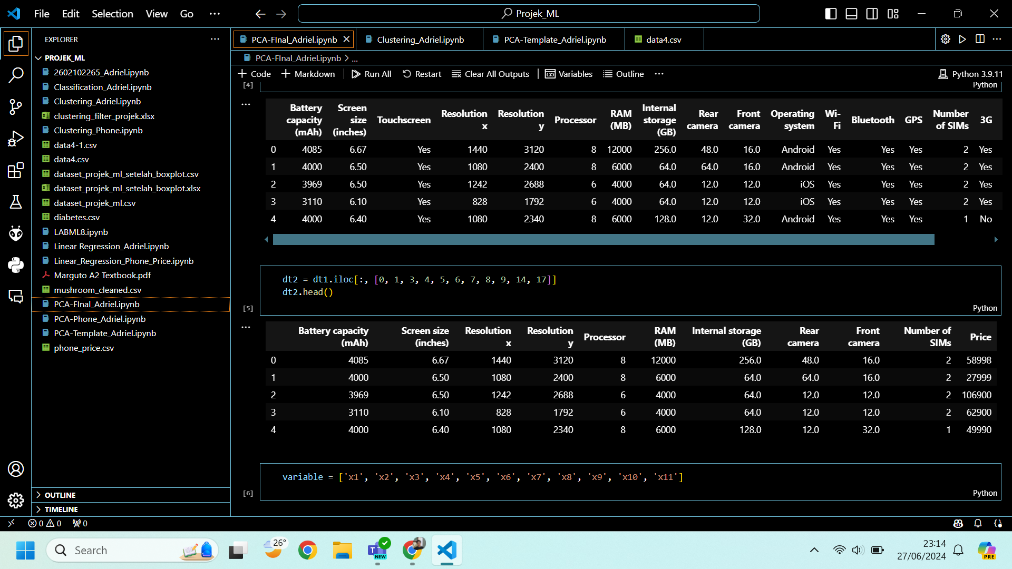
Preprocessing Data
Checked for any duplication and missing value.
Columns with data type besides float or integer were removed (include the first column named ‘#’).
The dataset after this process will be called a dataframe in the upcoming process.

Slide 9
PCA
The dataframe’s columns will be analyzed to determine which columns to use for the modeling dataframe, started by making the components based on the number of Eigenvalues created. The number of Eigenvalues created is minus one than the total number of columns in the dataframe input. In this case, there are 11 columns which means the number of Eigenvalues created is 10.
Check for the values that have e-0… in the back which indicates that the actual decimal values are 0,…. Which means that the values are less than zero. These particular values are going to be removed.
Make the loading score of all columns for each component. After all components are ready, for each column which in this case are the rows, find the highest value for each row.
Choose the component where it has the most amount of the highest values found previously. These rows with the highest values are going to be used in the dataframe for the making process of the machine learning model.

Slide 10

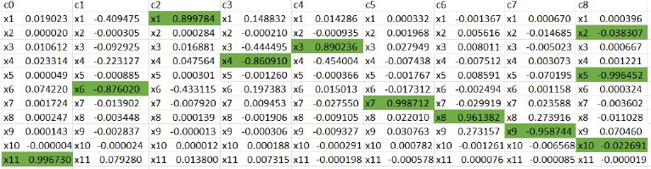
PCA RESULTS

Slide 11
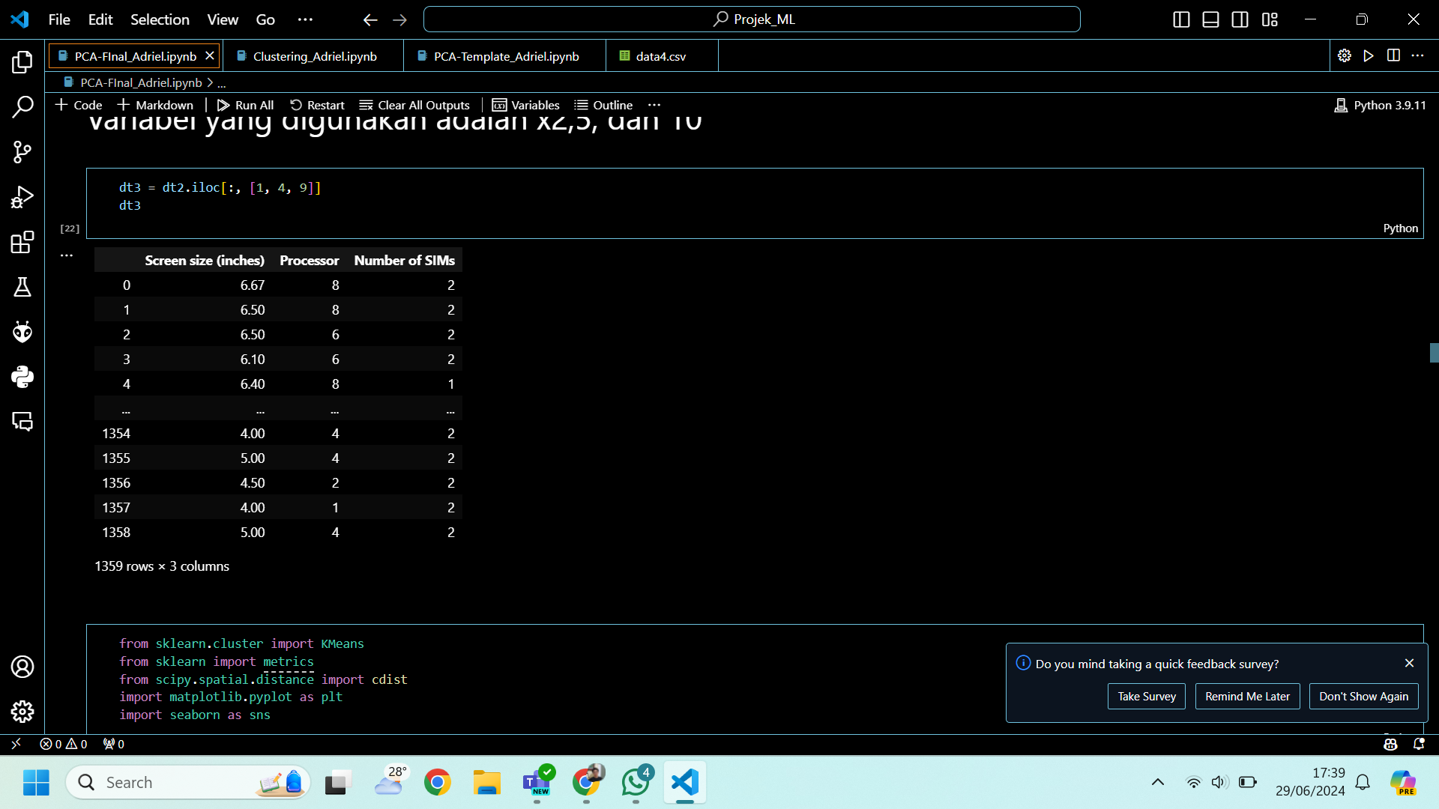
DATAFRAME AFTER PCA

Slide 12
Outliers Filter

Slide 13
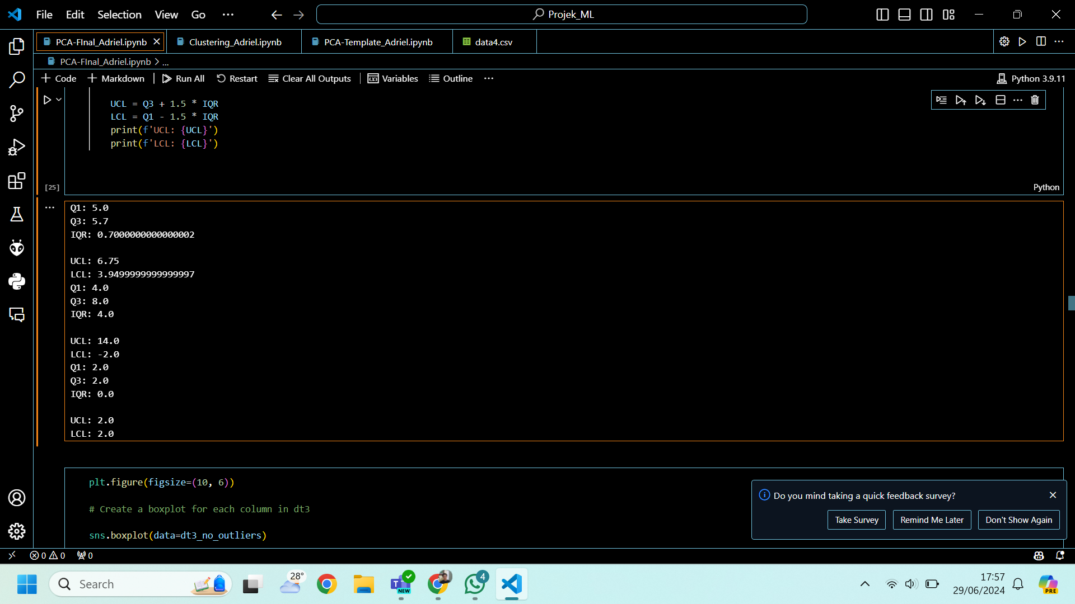
UCL AND LCL
This parameters are very important in removing the outliers
Each columns or variables have their own UCL and LCL values
UCL or Upper Control limit represent the highest value of the average data in the column
LCL or Lower Control Limit represent the lowest value of the average data in the column
Formulas for:
UCL = Q3 + 1.5 * IQR
LCL = Q1 - 1.5 * IQR
IQR = Q3-Q1

Slide 14
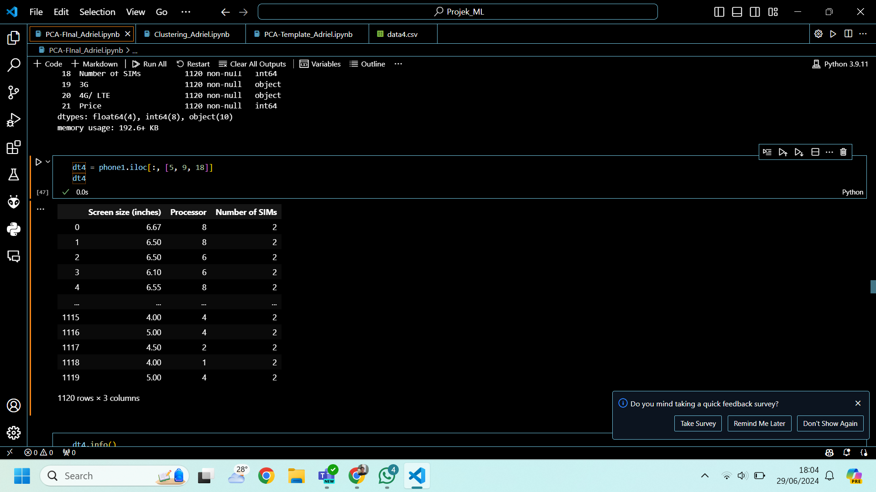
DATAFRAME AFTER OUTLIER FILTER

Slide 15
Clustering

Slide 16
STEPS
Distortions using Elbow Method
Making models using the combinations of two variables that are present in the dataframe

Slide 17
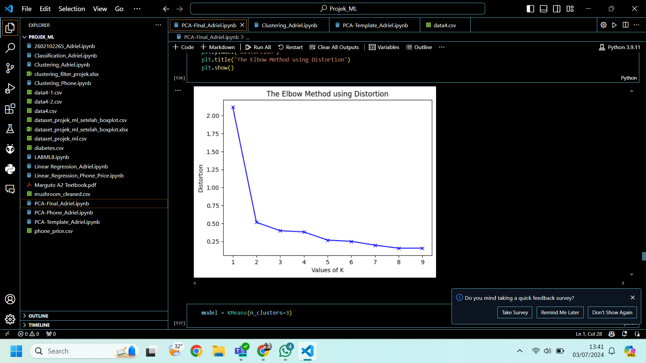
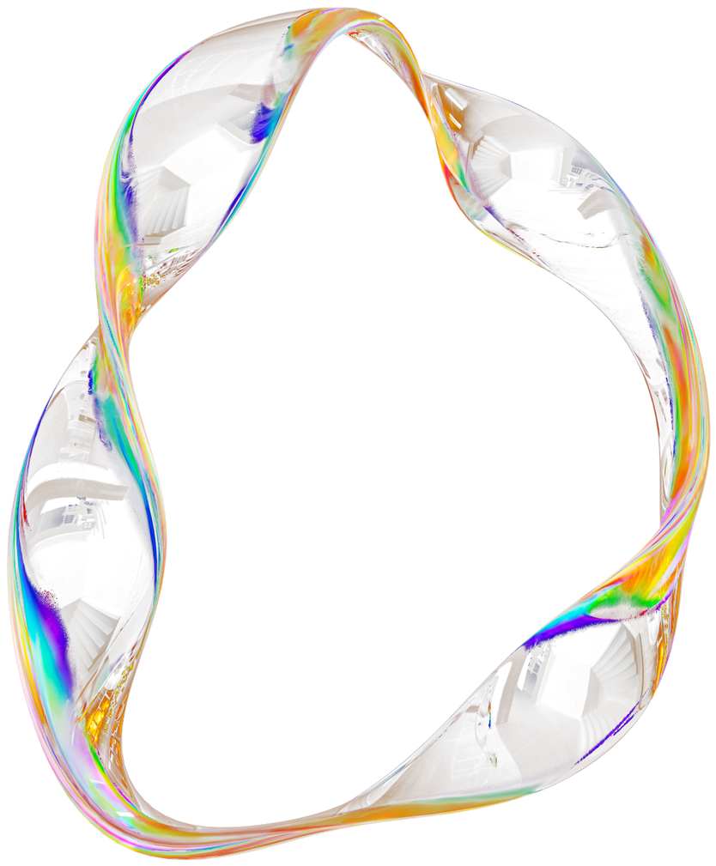
DISTORTION RESULT
THE RESULT IS 3 CLUSTERS

Slide 18

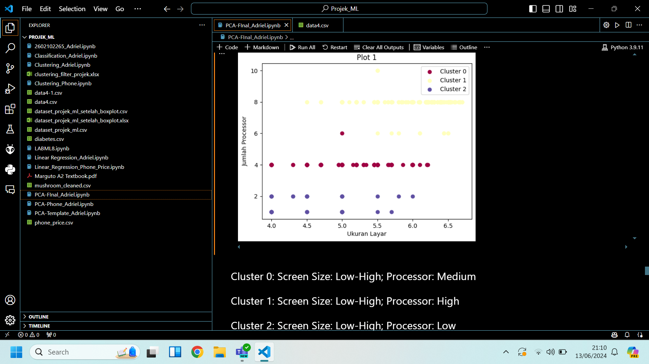
1ST PLOT

Slide 19
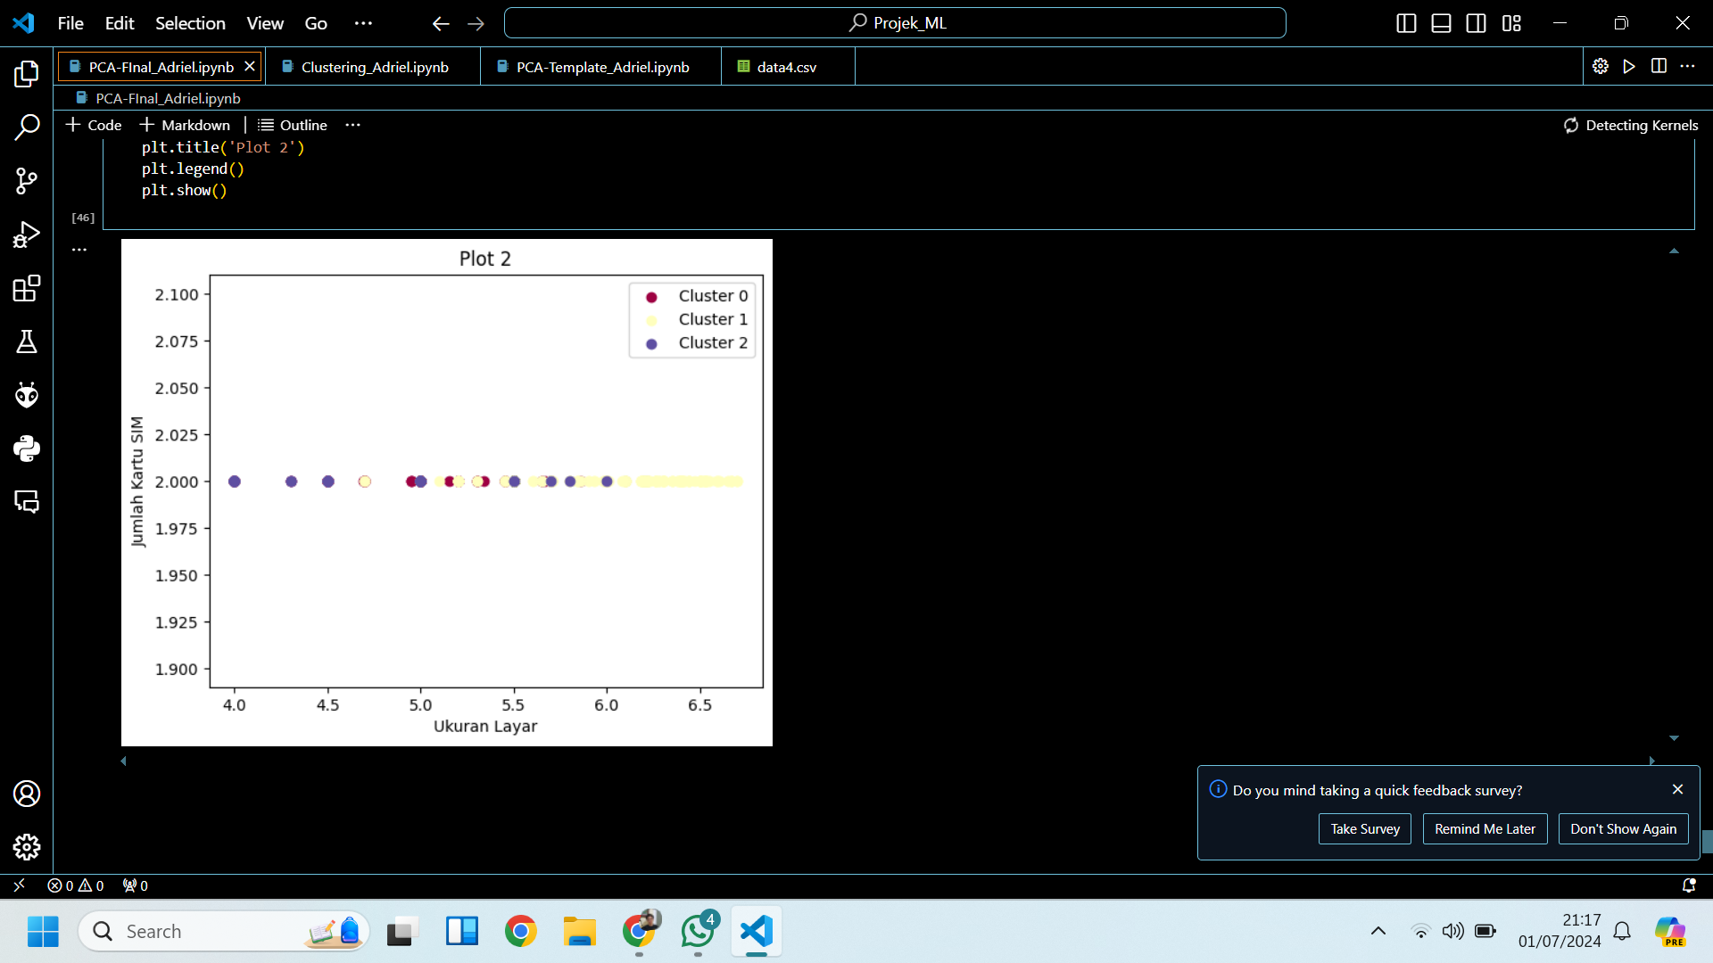
2ND PLOT

Slide 20
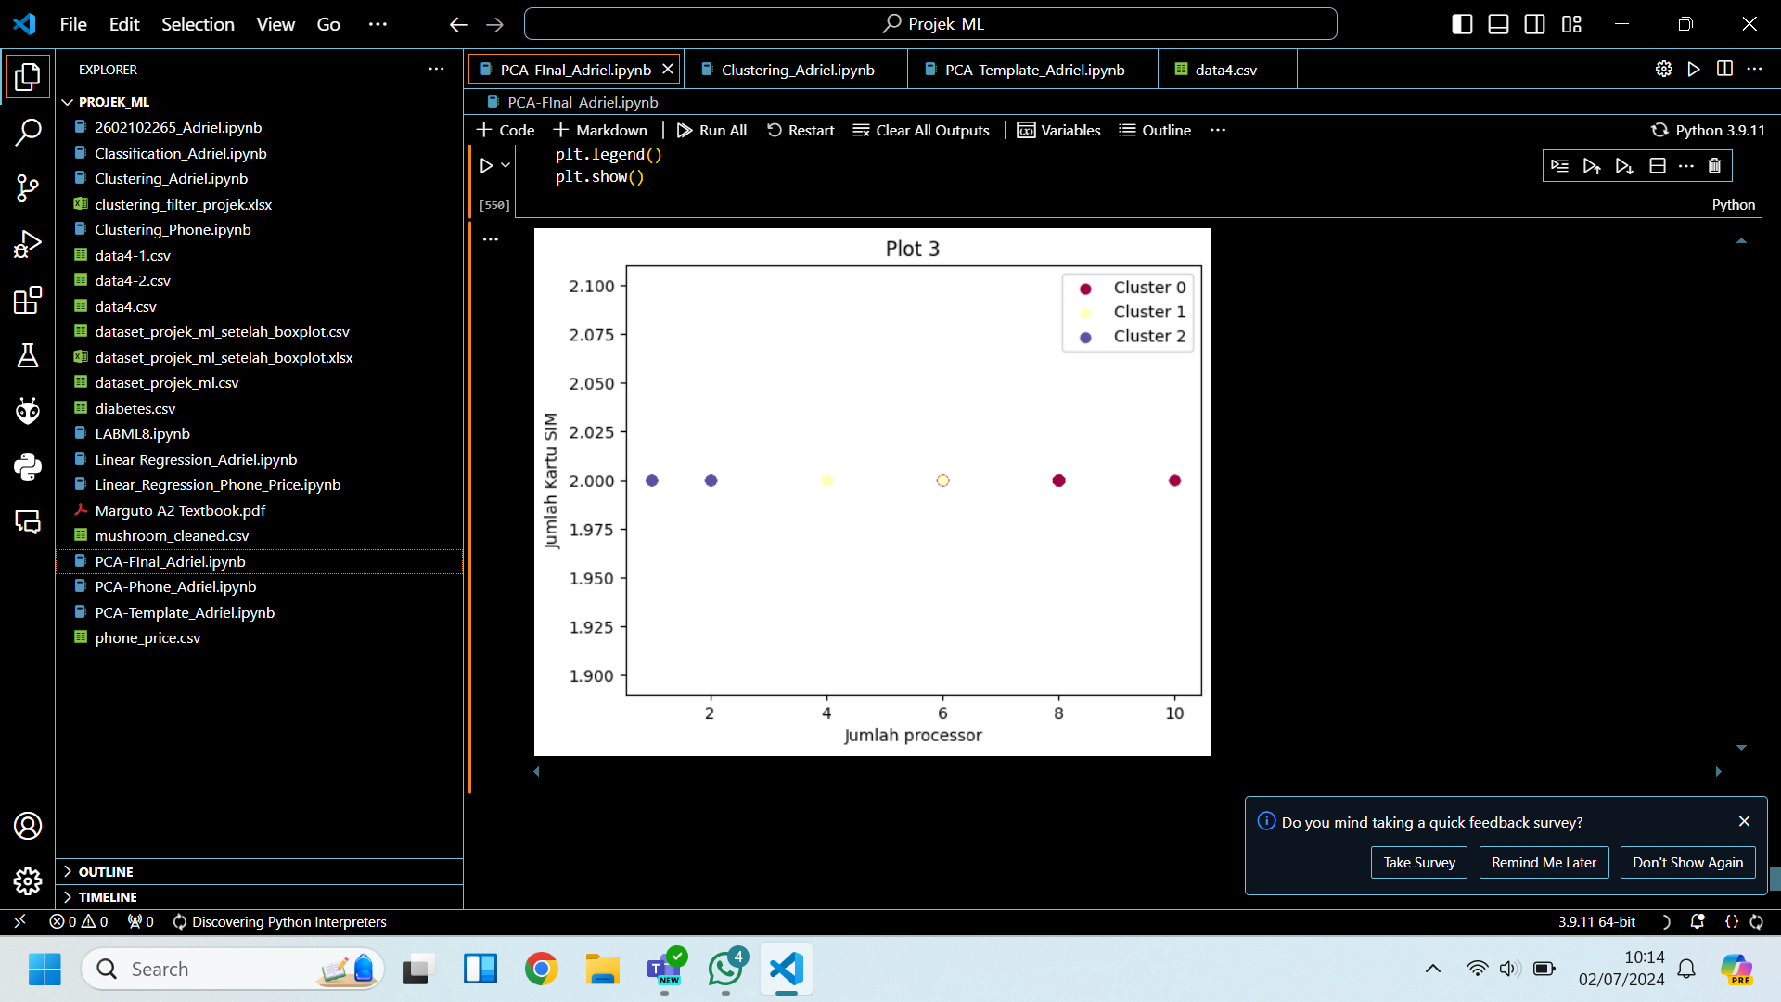
3RD PLOT

Slide 21
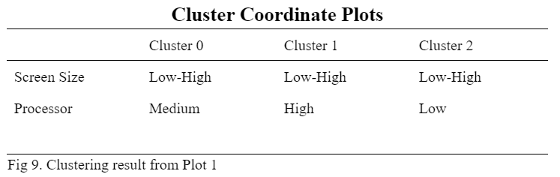
CLUSTERING RESULT FROM PLOT 1

Slide 22
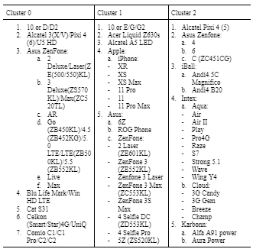
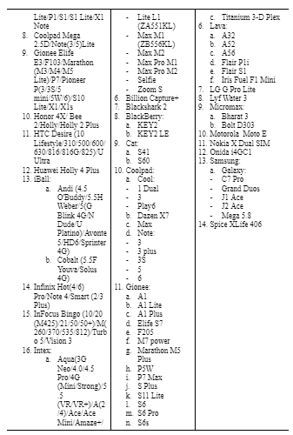
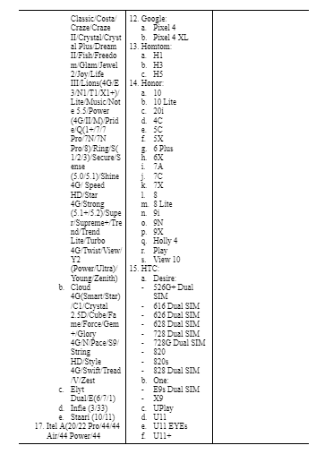
Clustering Phone Table

Slide 23
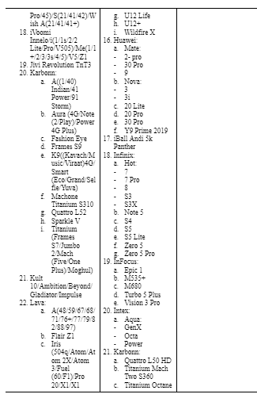
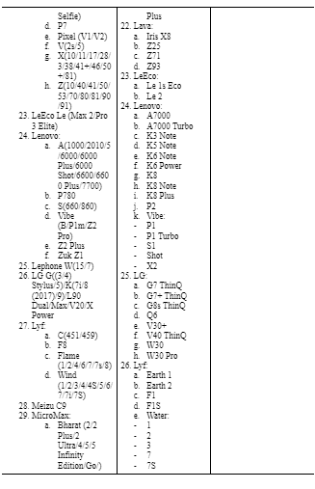
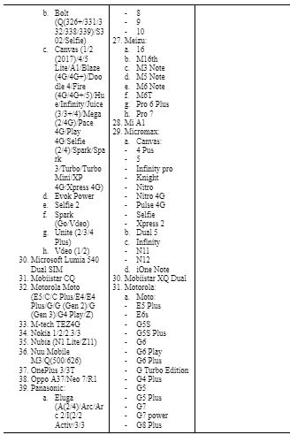
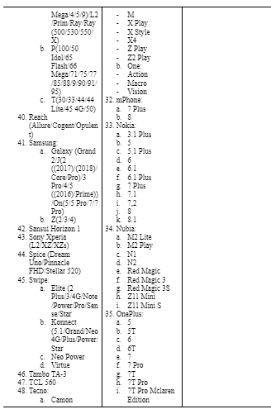
Clustering Phone Table

Slide 24
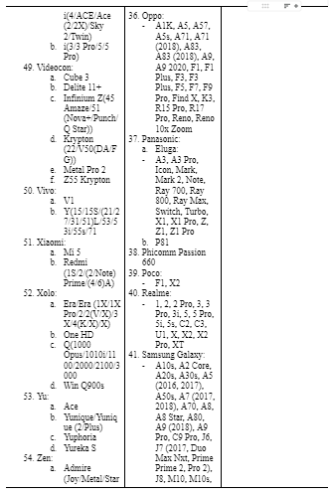
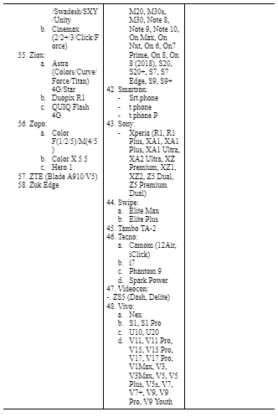
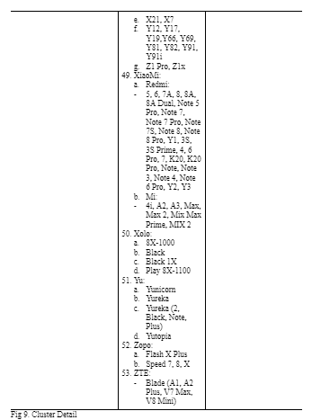
Clustering Phone Table

Slide 25
CONCLUSION
Throughout our study about the utilization of machine learning models, such as PCA (Principal Component Analysis), Outliers filter, and also clustering in classification of different smartphone specifications, we can discover more about the possibilities and potential from the usage of those models to the data processing issue. Along with the results of our practice above from our collected data
The most important part of the phone that influences its performance and types are screen size and the number of processors present inside the phone.
Usage of PCA (Principal Component Analysis) is an effective and efficient method of data analysis and visualization where it helps in reducing dimensionality and identifying key patterns.

Slide 26
Thank You

